Slide 1



G-rank:::Google Partner

Slide 2

G-rank, Google Official Partner and an ISO 9001:2008 Certified Company
G-rank:::Google Partner (eAnswer Group), incorporated in 2010, brings a truly global perspective to Digital Media Marketing, such as Google 1st Page Ads, Google Display Networks, Gmail Ads, Google Remarketing, YouTube Ads, Search Engine Optimization, Social Media Marketing and other promotional activities carried out for our clients.
More than 6 years of a strong, customer-focused approach and the continuous quest for world class quality in the services we offer to clients has enabled us to attain and sustain leadership in our line of business.

Slide 3

Core Values
Our Core Values lies in being committed to :
Deep understanding of client’s business and delivering services that lets them taste results
Striving for excellence in all we do for our clients
Aspiring individually and collectively to be more tomorrow than we are today.
100% ethical and transparent practices.

Slide 4


Social Media Division is a self defined entity, which forms an important part of eAnswer Group. The Social Media Division has been brought into existence for exclusively offering all kinds of Social Media Marketing and Promotional Services to clients. Here, we promote our clients in all major Social Media Websites like Facebook, Twitter, Google plus, LinkedIn, and other major Social Networking Website
www.smoclicks.in

Slide 5


Mr Creative is a vital segment of eAnswer Group consists an exclusive team of professionals working on Web Design, Web Development like PHP Development, CMS Websites Development like Word Press, Joomla and they hold immense expertise in Designing and Developing of an e Commerce Website . Strongly holding belief in quality, innovation and performance, our Mr Creative has attained highest level of customer satisfaction and trust through their unique and eye-catching website and logo designs and highly responsive web developments.
www. mrcreative.co.in

Slide 6
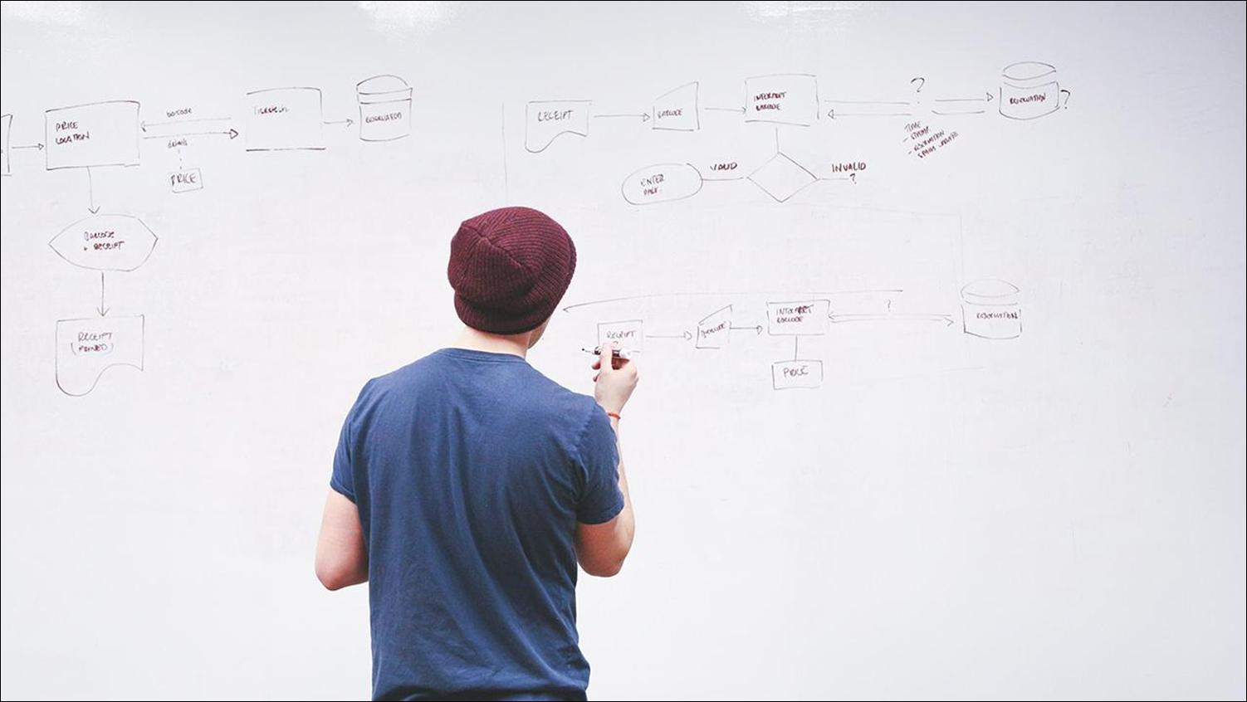
Clients We Serve:
Manufacturers
Exporters
Real Estate Builders & Developers
Educational Institutions
Hospitals
Local Business
Government Bodies
Shipping & Logistics

Slide 7

Sales
Coordination
Google Analyst
Design & Development
Project Handling Teams
SMO Analyst
Content Development
G-Live Serv
Customer Support

Slide 8
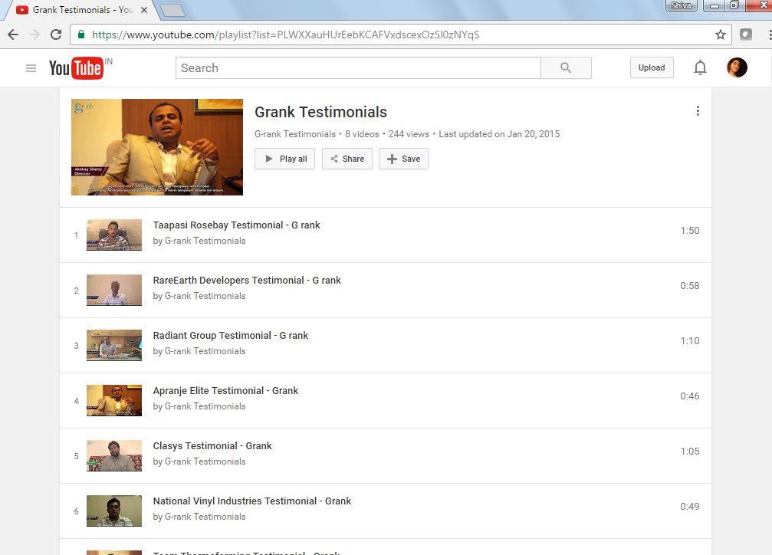
Our Clients - About Us:

Slide 9
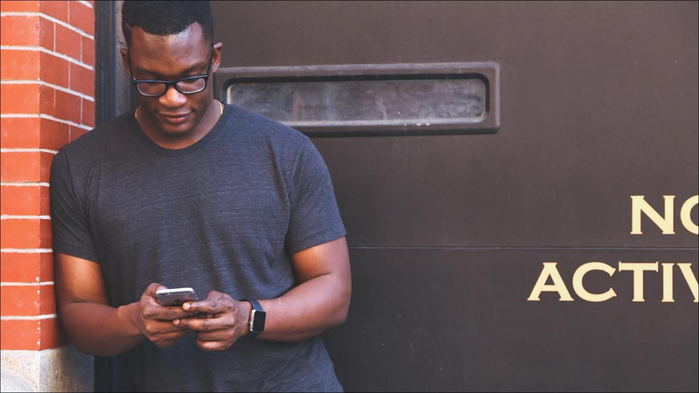
Thanks!
Mail us :
contact@grank.co.in
www.grank.co.in
or
Reach us on @
040-40079388/40136172

